Slide 1

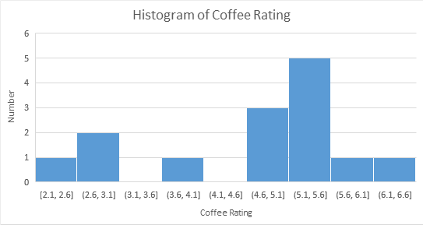
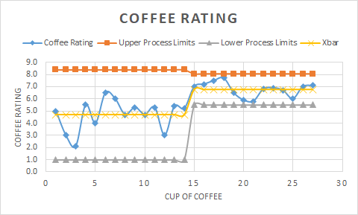
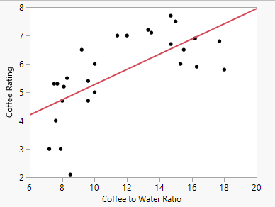
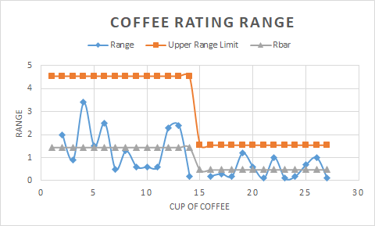

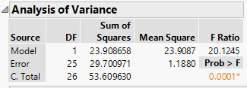
Process Improvement Project - Tasty Coffee
By Thomas P McGuire
Key Dates: Define: 07/20/20 Measure: 07/22/20 Analyze: 08/17/20 Improve: 08/31/20 Control: 09/09/20
DEFINE
MEASURE
ANALYZE
IMPROVE
CONTROL
Going to a coffee house is expensive.
It is much cheaper if I make coffee at home.
The coffee I make is not very good tasting.
To save myself money and to enjoy my mornings more, I need to make better coffee.
Linear Regression helps identify the best ratio!
My process has definitely improved!
Initial
 | Before | After
Mean | 4.7 | 6.8
Median | 5.1 | 6.9
Mode | 3 | 7
The taste of my coffee was all over
the place.
SQL = 1.1
Better Coffee!
Bad Coffee!
RSquare: 0.445977
SQL = 2.1
By closely measuring the various
Inputs like the coffee to water ratio,
I can produce better tasting
coffee.
Keeping in mind the good ratios, it seems like my coffee is tasting better!
SQL = 1.1
Saving almost $500 a year.
Can still improve taste with different coffee beans.

Slide 2
Coffee Improvement Process
Thomas P. McGuire

Slide 3
Problem Statement
I am a certified caffeine addict. Buying coffee from my favorite local coffee house or Starbucks is quite expensive, so I want to make my own coffee.
However, my current process is not very good!
When I make coffee myself, it often turns out too bitter so I mask the bitterness with milk, sugar or spices. The coffee beans themselves have a great variety of flavors and by adding milk, sugar or other spices, it hides the natural flavors of the coffee bean.

Slide 4
Goals
My goal for this process improvement is simple.
Make better and more consistent tasting coffee.
I will grade my coffee out of 10.0.
If I can consistently grade my coffee as 7.5 or higher, than it is successful.

Slide 5
Details about the data
I measured the amount of coffee, temperature of the water, amount of water and ice added, amount of time for the coffee to “bloom”, and the grind size. Most of my data was continuous including final coffee rating with the exception of grind size, which was discrete. I then calculated the coffee to water ratio and after my first sip, I gave my coffee a rating. All data was measured at the time of brewing and kept in an Excel workbook.
Measurement error: There were several places that measurement error came into play, such as in my coffee to water ratio calculation. There is some variability in the thermometer. There is uncertainty in the scale used to measure the amounts of coffee and water. I attempted to minimize my error by waiting to round til the end of the calculation. I used two different thermometers occasionally.

Slide 6
Sigma
Quality
Level
I define a defect in my process as being 6.0 or lower.
Defects per Cup of Coffee: 1
Cups of Coffee per week: 8
Total Possible Defects per week: 8
Actual Defects per week: 5
Defects / Defect Opportunity Rate: 5 / 8
Defects per Million Opportunities: 5 / 8 * 1,000,000
My current method of brewing coffee: my SQL is 1.1.

Slide 7
Sample Size
Using the sample size calculation, I need to have 13 samples for before and after my process change. Since I have a relatively small population, the standard deviation can be calculated for the population. As I am the only one affected by this process improvement, I was willing to have larger error in my final error.
Sample Size formula:
(
2
Z* x Sigma
)
= n = 13
E

Slide 8
Data Stratification Tree
Questions about the Process | Output | Stratification (x) | Measurements
Is y affected by grind size? | Y = Final Rating of Coffee = f ( x ) | X1 = Grind Size | Grind Size as determined by my electric burr grinder.
Is y affected by the water temperature? |  | X2 = Water Temp | Temperature of Water in degrees C as measured by a thermometer right before pouring.
Is y affected by the amount of time the coffee is bloomed? |  | X3 = Coffee Bloom Time | Time coffee is bloomed in seconds using the clock on my microwave
Is y affected by coffee to water ratio? |  | X4 = Coffee to water ratio | Coffee to water ratio calculated by myself using a calculator
Is y affected by the amount of coffee? |  | X5 = Amount of coffee | Coffee amount in grams using a kitchen scale
Y = f(X1 + X2 + X3 + X4 + X5)
All data collected by me!

Slide 9
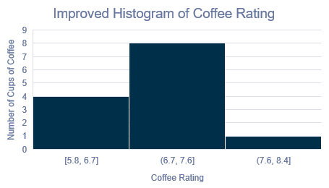
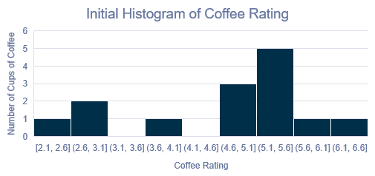
Histogram Of Coffee Rating
My initial process is on the left and my improved process is on the right. I counted all the cups of coffee I drank for both histograms. There is some tailing in the original process, with values in a very wide range. In the improved process, there is a tighter normal distribution which shows more consistent taste.

Slide 10

Simple Linear Regression
I decided to do Simple Linear Regression of the amounts of coffee to water ratio against the coffee rating, using an alpha of 0.1.
RSquare: 0.445977
Coffee Rating = 2.5941479 + 0.2677686*Coffee to Water Ratio
This is a good starting point as this is a critical relationship to what makes a better cup of coffee.

Slide 11
Mean, Median and Mode of Final Coffee Rating
 | Before | After
Mean | 4.7 | 6.8
Median | 5.1 | 6.9
Mode | 3 | 7
I wanted to know what the Measures of Central Tendency would say about my final coffee rating. As shown, I am averaging almost 1.5 lower than what I consider a defect in before my process improvement! The center of all my data points before the data improvement was almost a full point lower as well. After my process improvement, the center of my data and the average are almost a full point higher my defect limit. A higher final coffee rating means that my coffee tastes better.

Slide 12
Hypothesis Testing
Null Hypothesis: The taste of my coffee has not improved.
Alternate Hypothesis: The taste of my coffee has improved.
 | Before | After
Xbar | 4.7 | 6.8
s | 1.244968 | 0.590415
n | 14 | 13
I used an alpha of 0.1 Using the green chart, lower / left tail, I got a z value of -5.68. Using the chart from our book, that value is not there and therefore, p is very close to zero. 0.1 > 0 so, p is low and Ho must go! Thus, there was an improvement the taste of my coffee.

Slide 13
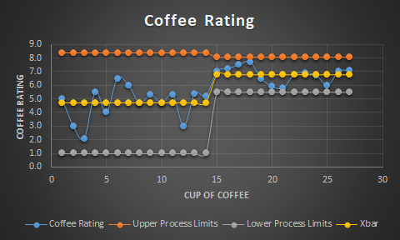
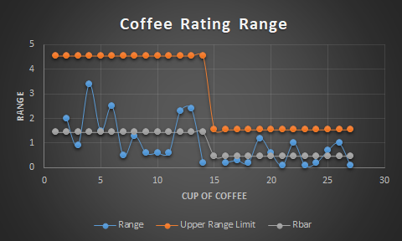
Moving Range Chart
Both before and after my process improvement, my process is in control. Where there is a steep line, that is where I started my process changes. The process limits became much tighter and there was much less difference between the final ratings. Thankfully, my processes did not appear to have any patterns. The average of my coffee rating is higher, which indicates it is better tasting coffee. There is less change between cups which means it is more consistent.

Slide 14
Conclusion
Thanks to my several tools used, there has been an improvement in my morning coffee routine. My old process was very haphazard and it resulted in my coffee being wildly inconsistent. My new process is much more stable yet still has room for improvement as I did not get above my initial goal. I achieved the consistency I was looking for but not quite the rating.
My Sigma Quality Level currently is 2.1. This is a full level above where I started. My number of defects per week has dropped from 5 down to 2.
Between the SQL and not getting the rating I was looking for, there are still improvements to be made!

Slide 15
Next Steps
Some of the factors I chose ended up not being too impactful on the final rating.
There were a variety of other factors that I had not considered and did not account for that I would like to monitor in the future.
Some of the new factors I will be watching will be when the bean was ground to when it was used to make the coffee, when it was roasted or where the coffee bean was from.

